Slide 1
7PAM2000 Applied Data Science 1 Assignment 3: Clustering and fitting
Github link: https://github.com/shazaib001/assignment-3-clustering-and-fitting

Slide 2
Table of Content
Introduction
Clustering Results
Model Fitting Results
Error Calculation using err_ranges function
Conclusion

Slide 3
Introduction

Slide 4
Intro:Dataset Information
The dataset is from the World Bank and contains information about Gross Domestic Product (GDP) per capita, which is a measure of the average economic output per person in a given area.
The indicator code "NY.GDP.PCAP.PP.CD" stands for "GDP per capita, PPP (current international $)". PPP stands for "purchasing power parity", which adjusts for differences in cost of living across countries.
The data can be used to study the economic performance of the countries.
We use the data to compare the GDP per capita among the countries, and also over time.

Slide 5
Intro:Objective of the analysis
To study the GDP per capita of different countries
To find clusters of countries that have similar GDP per capita
To fit a model to the GDP per capita data to make predictions
To estimate the error ranges of the predictions

Slide 6
Intro:Objective of the analysis
To group countries by their GDP per capita data using the K-Means clustering algorithm
To fit the data with exponential growth model
To explore the trends in GDP per capita among the countries
To find patterns and insights in the data.

Slide 7
Clustering Results

Slide 8

Clustering Results
For clustering we need normalized data of GDP per capita. So,
Normalizes the GDP per capita data using MinMaxScaler from sklearn.
It uses the fit_transform() method to fit the scaler on the data and transform it
it uses '.loc[:,'2010':'2021']' to select the column from 2010 to 2021
The normalized data is stored in a variable 'data_scaled' and will be used for clustering analysis.

Slide 9
Clustering Results
For clustering we need normalized data of GDP per capita. So,
Normalizes the GDP per capita data using MinMaxScaler from sklearn.
It uses the fit_transform() method to fit the scaler on the data and transform it
it uses '.loc[:,'2010':'2021']' to select the column from 2010 to 2021
The normalized data is stored in a variable 'data_scaled' and will be used for clustering analysis.

Slide 10

Clustering Results
Uses the KMeans class from sklearn library to perform the clustering
uses n_clusters=5, which means that we will create 5 clusters of countries
then uses the fit_predict() method to fit the data and predict the cluster labels

Slide 11
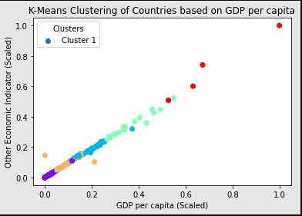
Clustering Results
then creates a scatter plot to visualize the clusters, where the x-axis represents GDP per capita (scaled), the y-axis represents other economic indicator (scaled), and the color of the points represents the cluster label
The plot is labeled with a title, x-axis label, y-axis label, legend, and captions
Plot is shown using plt.show() from pyplot.

Slide 12
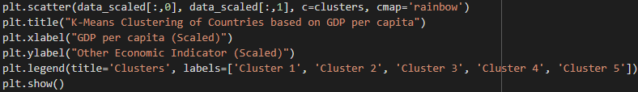
Clustering Results
Plotting Code for Visualization:

Slide 13
Model Fitting Results

Slide 14
Model Fitting Results
For Model Fitting function 'exponential_growth' is used that takes in two parameters (x, a, b) and returns the exponential growth of x with parameters a and b.
First reshapes the x variable to ensure that it is in the correct format
then defines x_data as the index of dataframe and y_data as the 2020 column

Slide 15
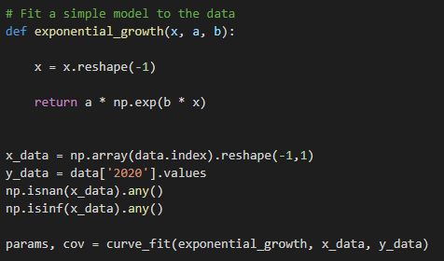
Model Fitting Results
For Model Fitting function 'exponential_growth' is used that takes in two parameters (x, a, b) and returns the exponential growth of x with parameters a and b.
First reshapes the x variable to ensure that it is in the correct format
then defines x_data as the index of dataframe and y_data as the 2020 column

Slide 16
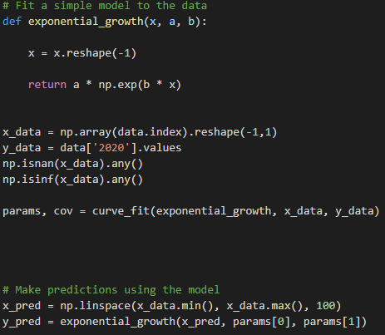
Model Fitting Results
checks if x_data contains any NaN or Inf values and eliminates them
then uses curve_fit function from scipy to find the best parameters for the function
After that uses the function to predict the values and store them in y_pred variable

Slide 17
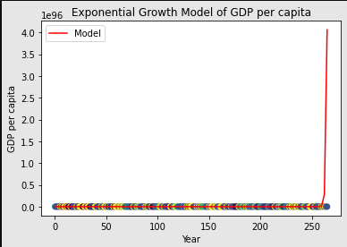
Model Fitting Results
plots the data and the model using plt.scatter and plt.plot functions
Then uses the plt.show() function to show the plot
calculates the error ranges using the err_ranges function for the fitted model

Slide 18
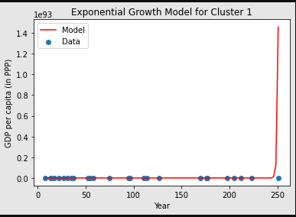
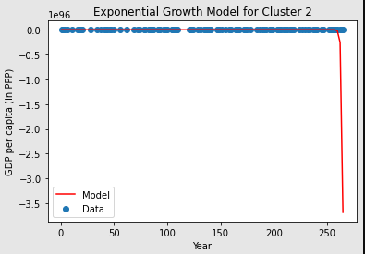
Model Fitting Results

Slide 19
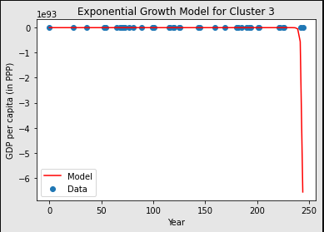
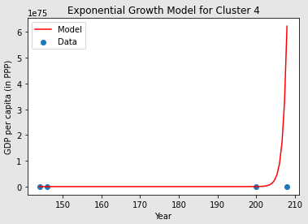
Model Fitting Results

Slide 20
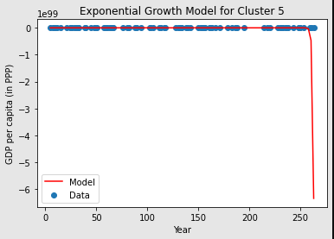
Model Fitting Results

Slide 21
Error Calculation using err_ranges function

Slide 22
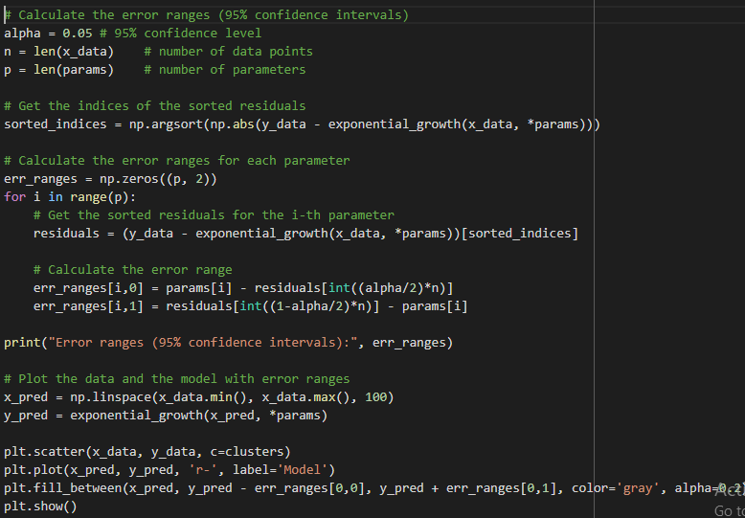
Error Calculation
calculates the error ranges (95% confidence intervals) for the fitted mode
The function uses the sorted residuals of the model to calculate the error ranges
It takes the alpha value (0.05) as input, which represents the confidence level (95%)

Slide 23
Error Calculation
It takes the number of data points (n) and the number of parameters (p) as inputs
It calculates the error range for each parameter by subtracting the residuals from the parameters
It returns the error ranges for each parameter in an array
The script then prints the error ranges for reference

Slide 24
Error Calculation
Clusters | Error using err_ranges function
Cluster 1 | Error ranges (95% confidence intervals): [[-5.20848086e+04 -1.45804790e+93] [-5.20838086e+04 -1.45804790e+93]]
Cluster 2 | Error ranges (95% confidence intervals): [[-9.58077038e-03 1.83385701e+95] [ 9.90419241e-01 1.83385701e+95]]
Cluster 3 | Error ranges (95% confidence intervals): [[-4.03395956e+04 6.56585200e+93] [-4.03385956e+04 6.56585200e+93]]
Cluster 4 | Error ranges (95% confidence intervals): [[ 9.98946218e+47 -6.22857833e+75] [ 9.98946218e+47 -6.22857833e+75]]
Cluster 5 | Error ranges (95% confidence intervals): [[-1.47938813e+04 1.16021284e+98] [-1.47928813e+04 1.16021284e+98]]

Slide 25
Conclusion

Slide 26
Conclusion
The analysis used the GDP per capita data of different countries from 2010-2021
It performed K-Means clustering to group the countries into 5 clusters based on their GDP per capita.
The clusters were visualized using a scatter plot where the x-axis represents GDP per capita (scaled), the y-axis represents other economic indicator (scaled) and the color of the points represents the cluster label.

Slide 27
Conclusion
An exponential growth model was fit to the data and predictions were made for future years.
The error ranges for the predictions were calculated using the err_ranges function
The data and the model were plotted along with the error ranges
The results can be used to understand the trends in GDP per capita among the different clusters of countries and make predictions for future years.

Slide 28
Reference
Github deploy Link :
https://github.com/Shazaib001/Assignment-3-Clustering-and-fitting

